Slide 1




Multidimensional Analysis of HPV vaccination rates by state
Monika Baker
Betsy Campbell
Simone Longo
University of Utah
Department of Biomedical Informatics
April 27, 2020

Slide 2
Introduction
Human papillomavirus (HPV) affects 78 million Americans
Most cases are benign
Some lead to lesions, warts, and increased risk of certain types of cancers
HPV vaccine recommended for all people between 9-27 years old
Administered in 3 rounds

Slide 3
Questions we have
How do HPV vaccination rates correlate to:
Education spending
Sexual education program structure
Rates of HPV related cancers

Slide 4
Data Collection
Vaccination data
By state, gender, and proportion of population aged 12-17 that has received each round of vaccinations
Reported by CDC
Sex Ed data
Sex ed program structure data by state and what components of sex ed are required
Reported by Guttmacher Institute
Cancer Epidemiology data
HPV associated cancers by state
Includes anal, back of throat, cervical, penile, vaginal, and vulval cancers
Reported by CDC
Education data
Enrollment and spending by state
Reported by National Center for Education Statistics (NCES)

Slide 5
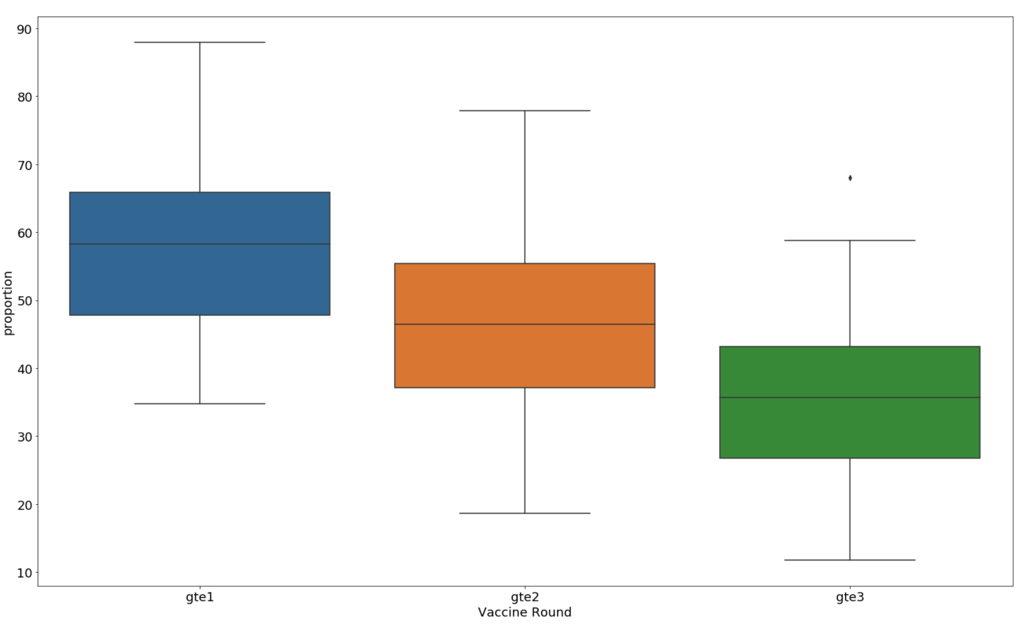
Overall HPV Vaccination Rates

Slide 6
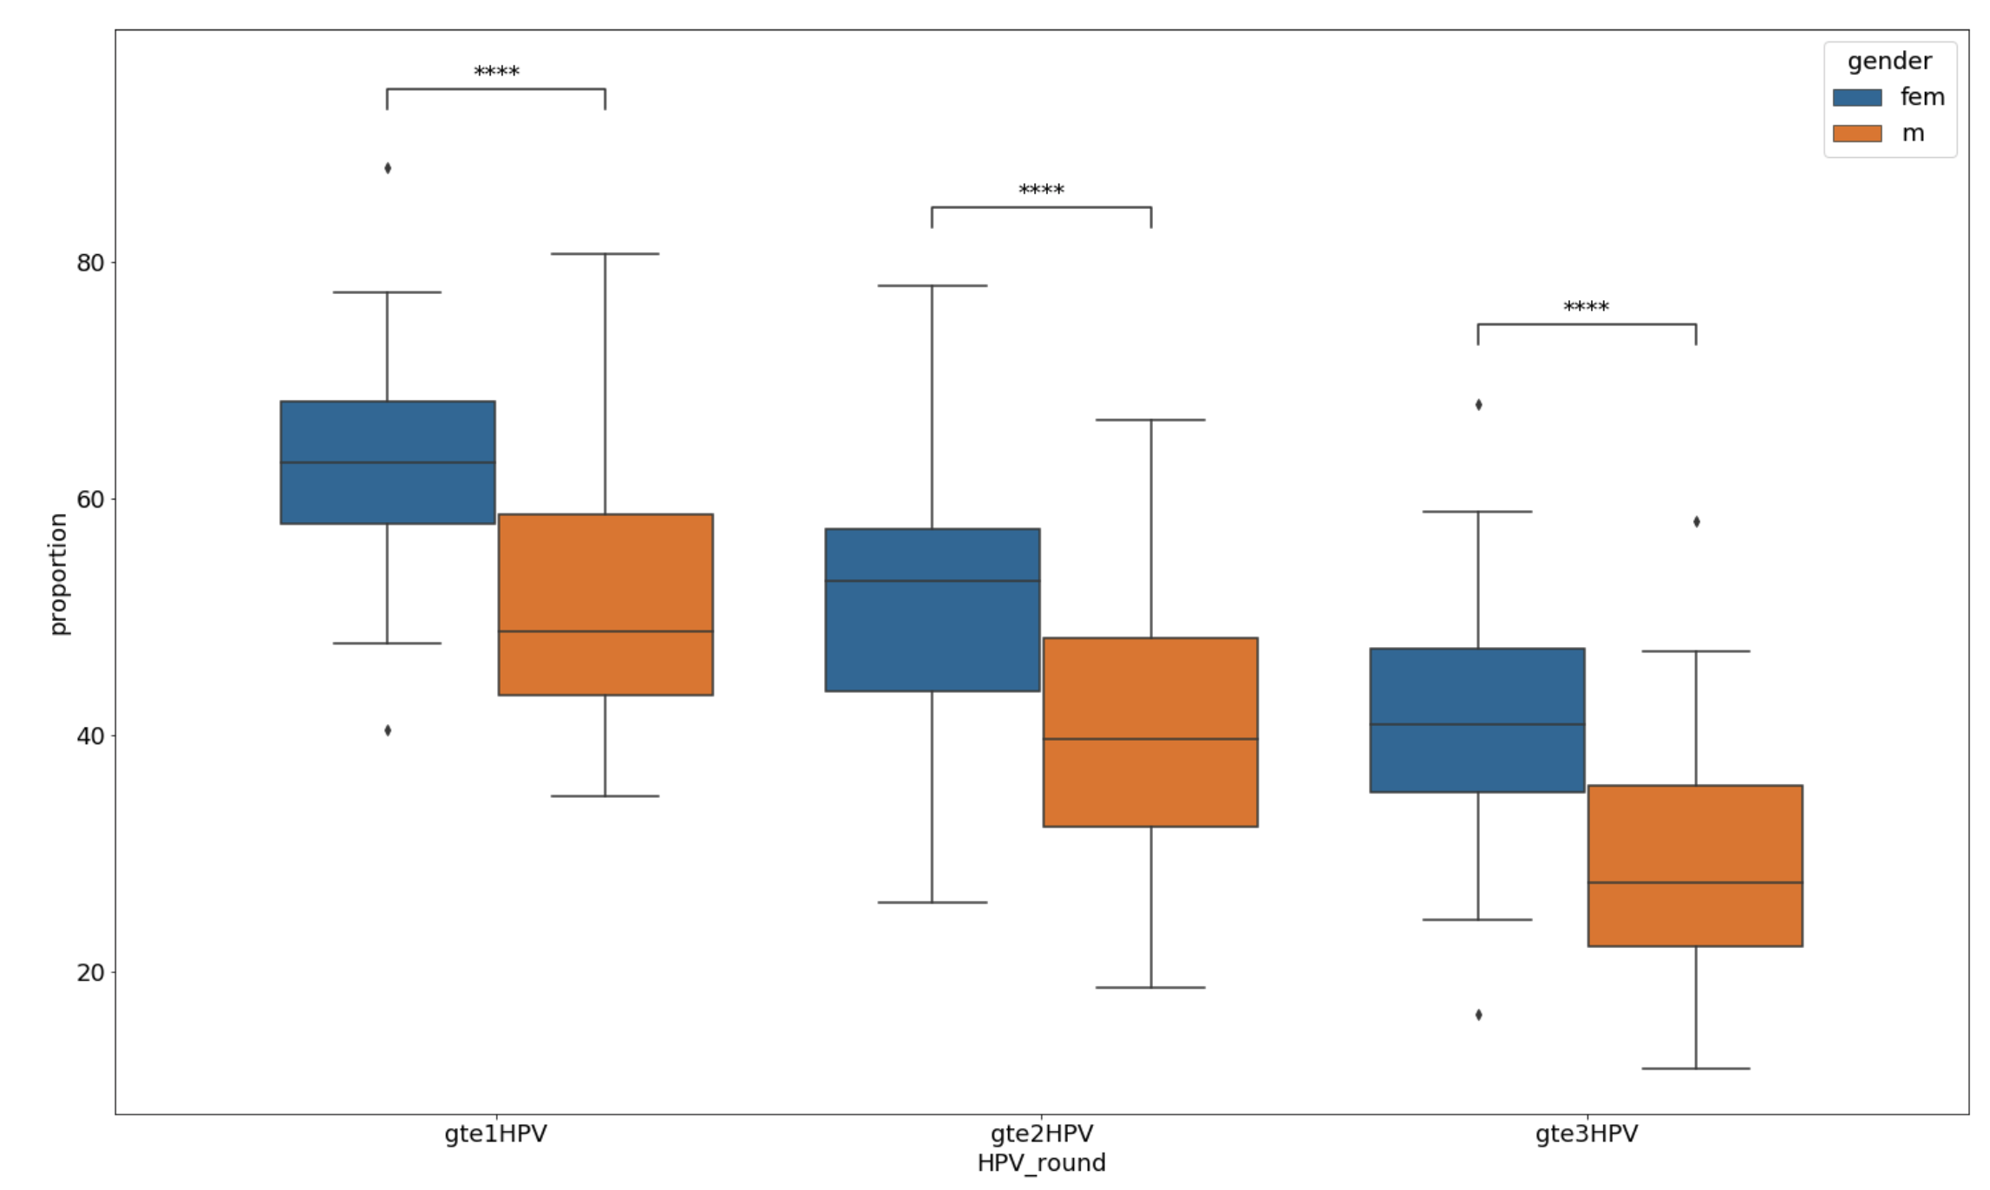
Overall HPV Vaccination Rates by Gender
Notes:
Mww p-values: 2.56e-7, 9.26e-08, 1.372e-08
Paired t-test: 1.2e-19, 9.9e-19, 1.1e-19

Slide 7
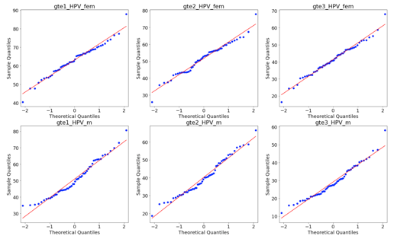
Distribution of HPV Vaccination Rates

Slide 8
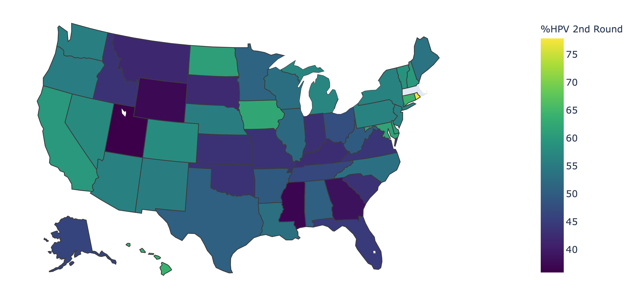
Overall HPV Vaccination Rates by State

Slide 9
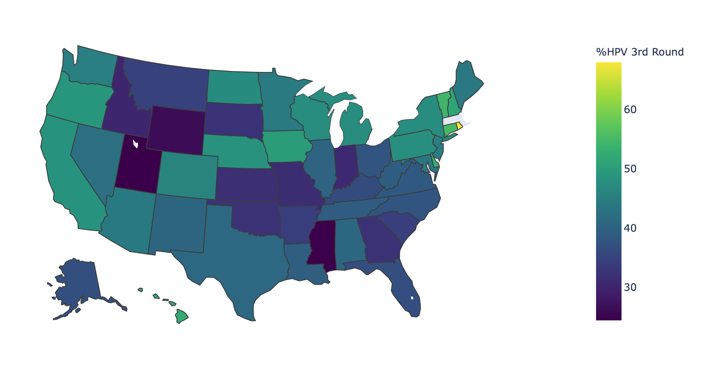
Overall HPV Vaccination Rates by State

Slide 10
Calculating Per Pupil Spending
NCES reports:
Actively enrolled students K-12
Total spent on education by state
Amount spent on student support
How does this relate to successful HPV vaccination rates (i.e. 2nd round and higher)?

Slide 11
Caveats
Assuming spending is uniform for all grades (probably is not)
Also that spending is a direct indicator of educational outcomes (likely more to the story)
Does not consider demographics
However, can capture an overall trend if it exists.

Slide 12
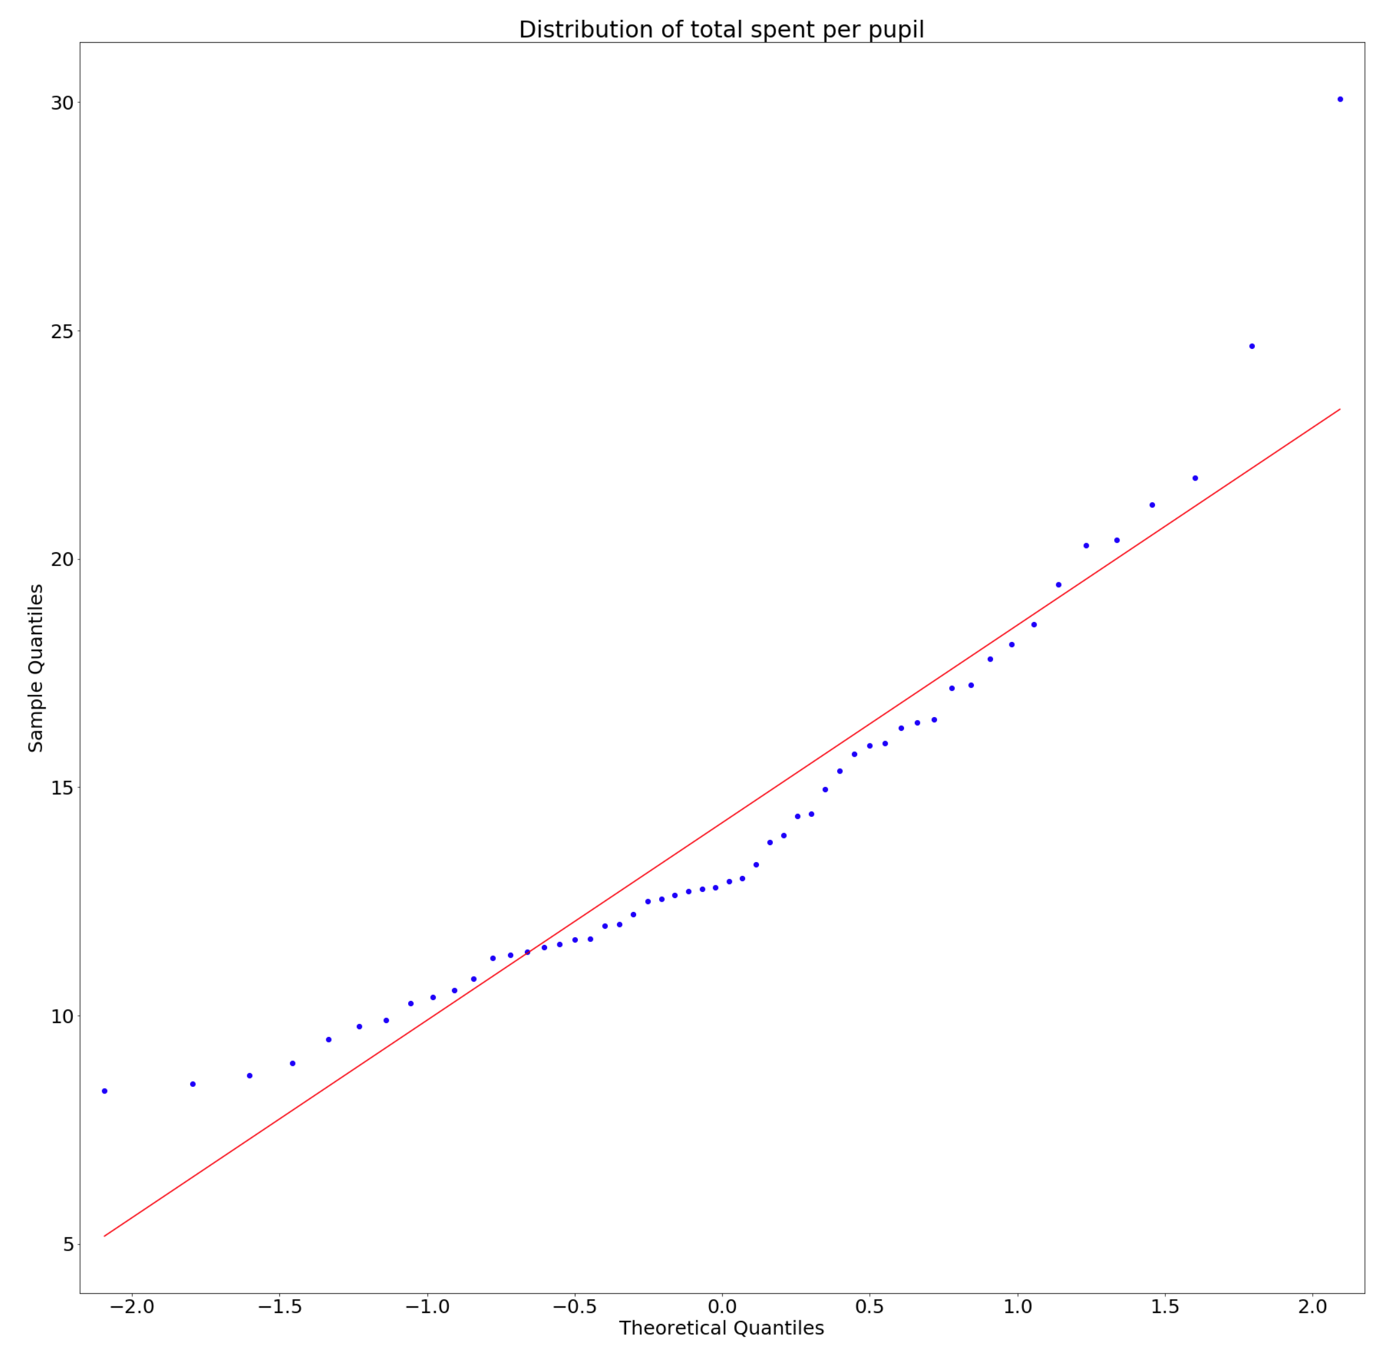
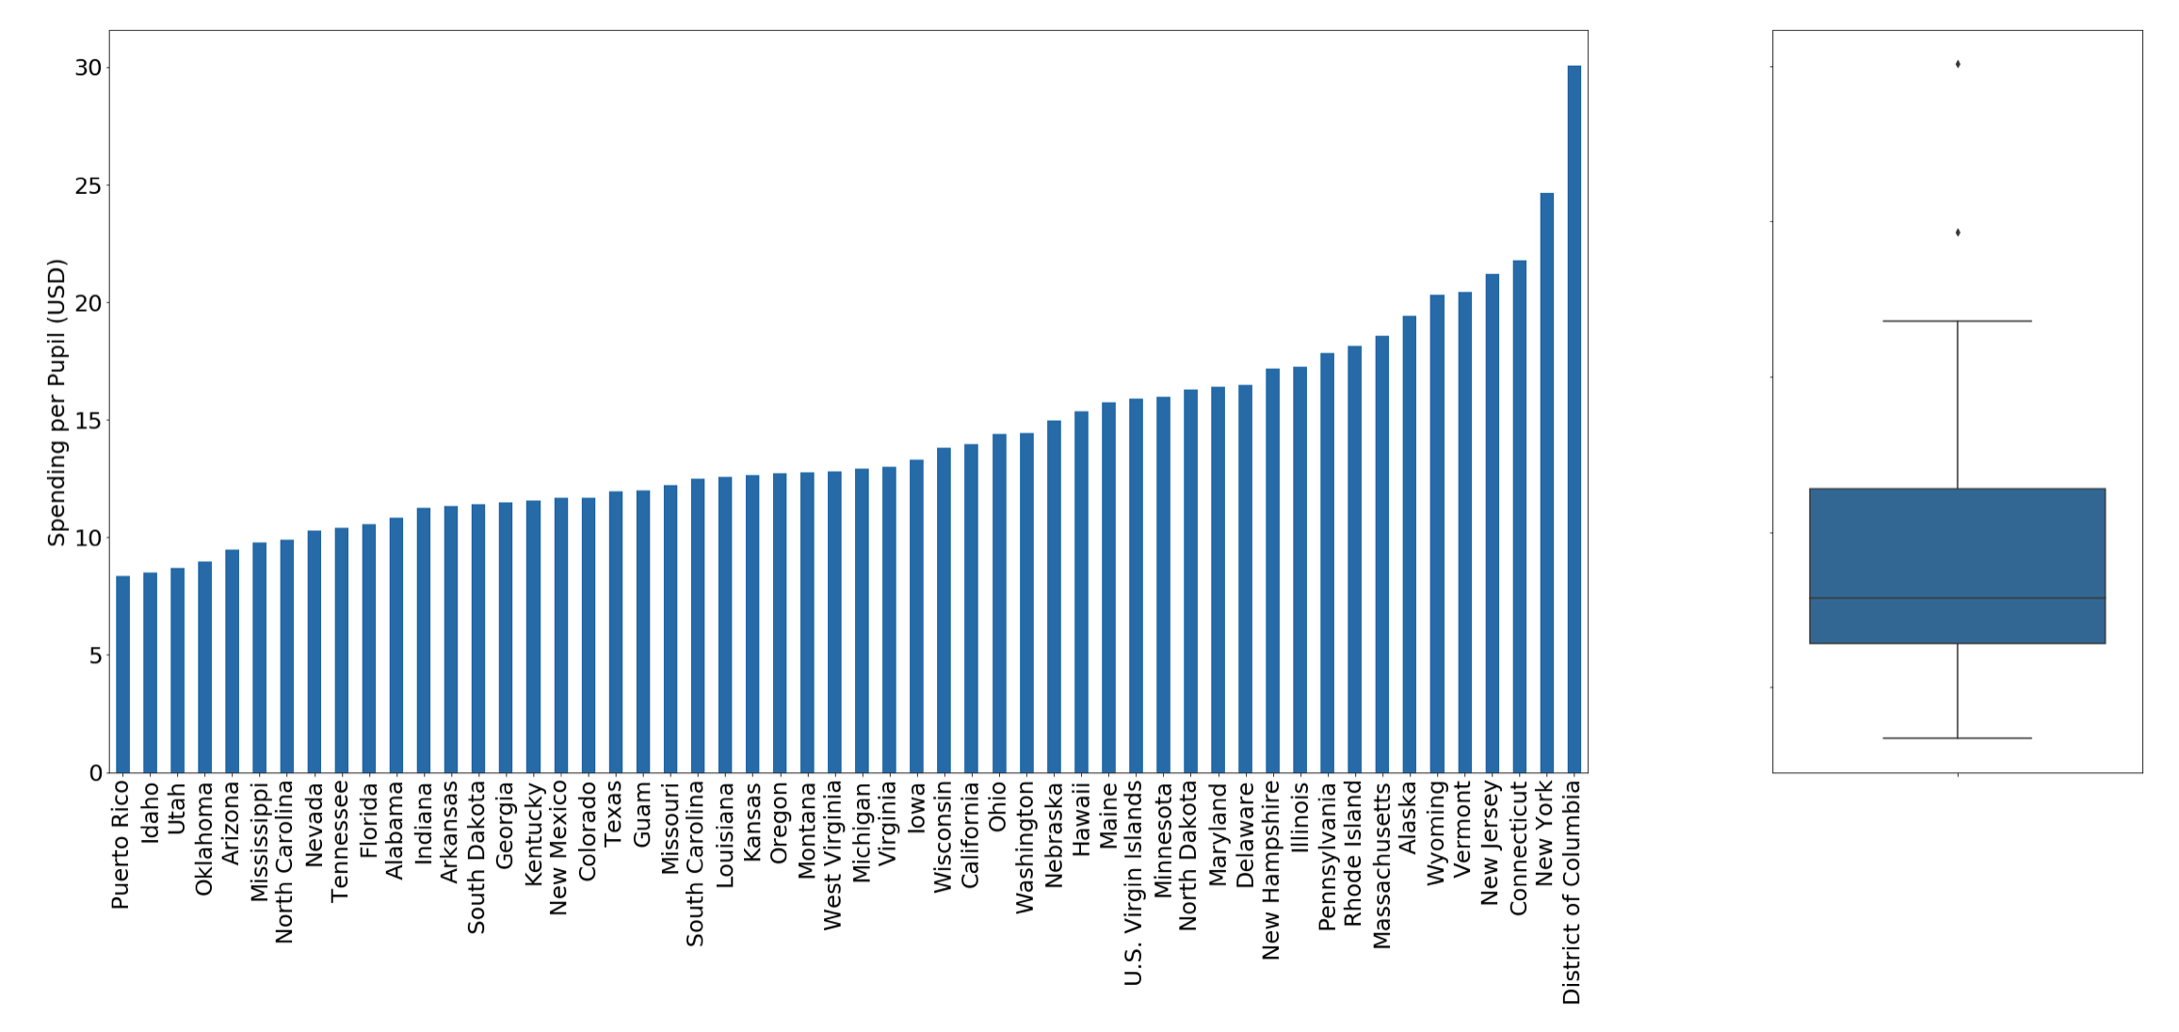
Per Pupil Spending

Slide 13
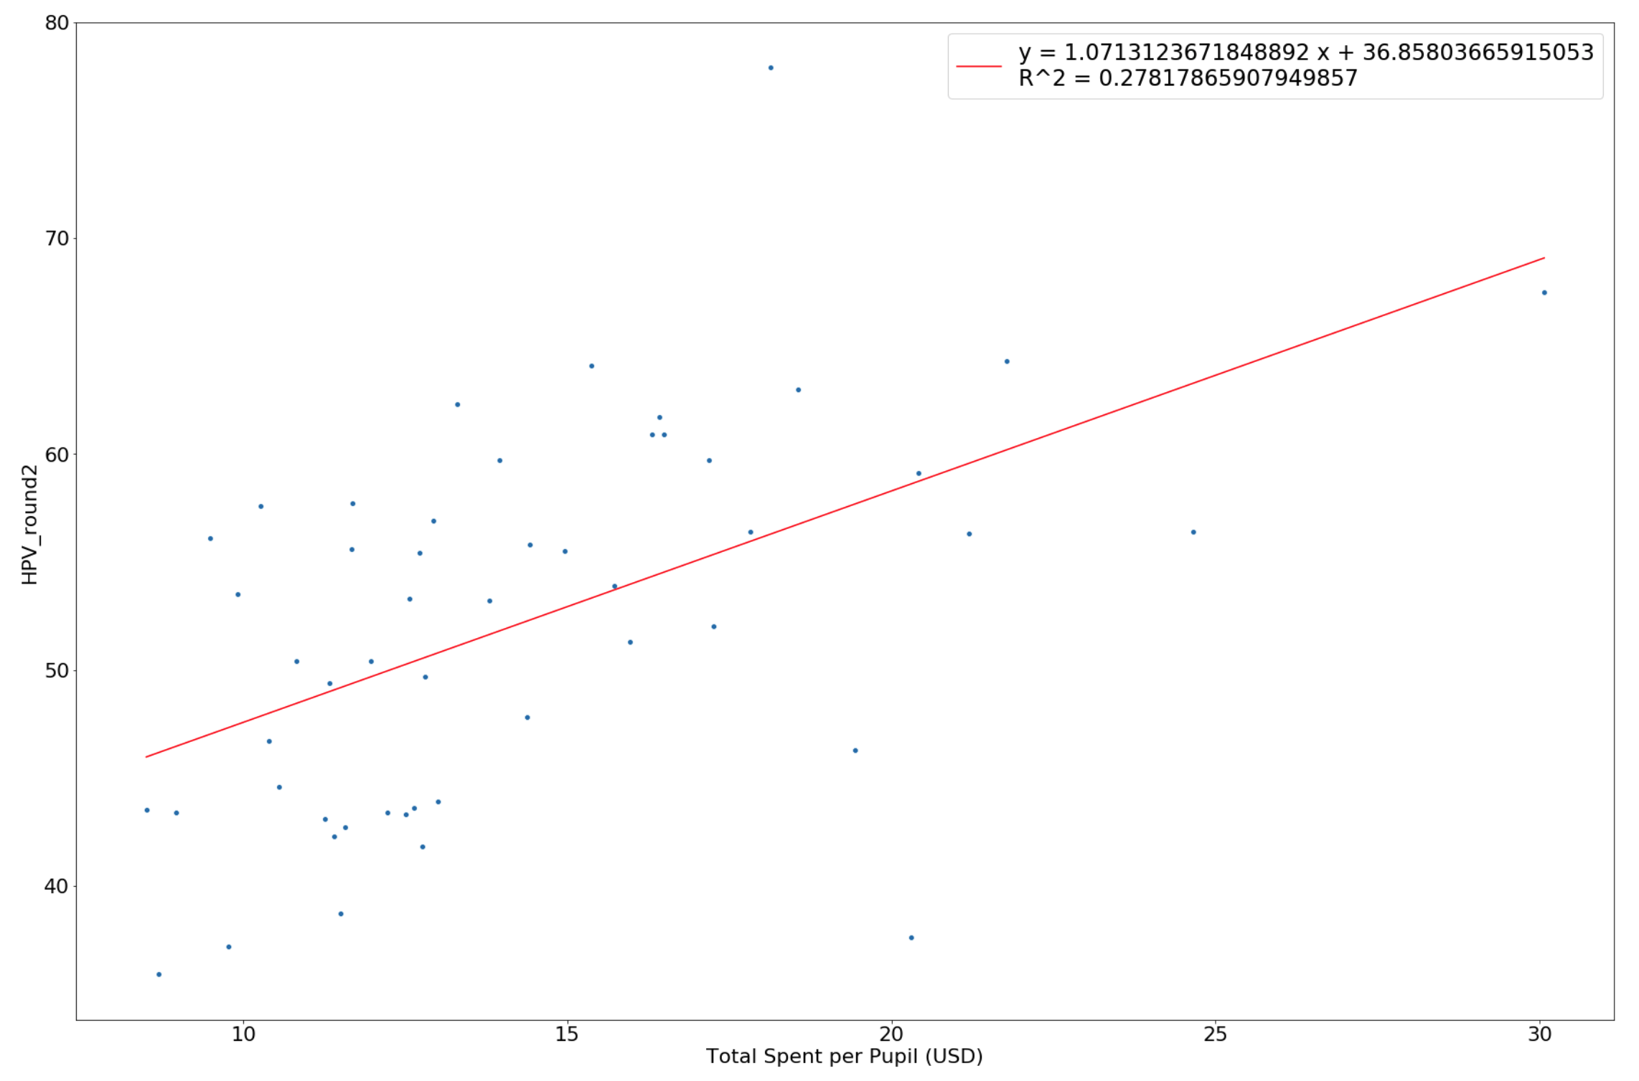
Correlating Total Spending with 2nd Round of Vaccinations
Notes:
f stat = 7.980396681547373e-07
Pearson = (0.5245360700946192, 7.779321343004095e-05)

Slide 14
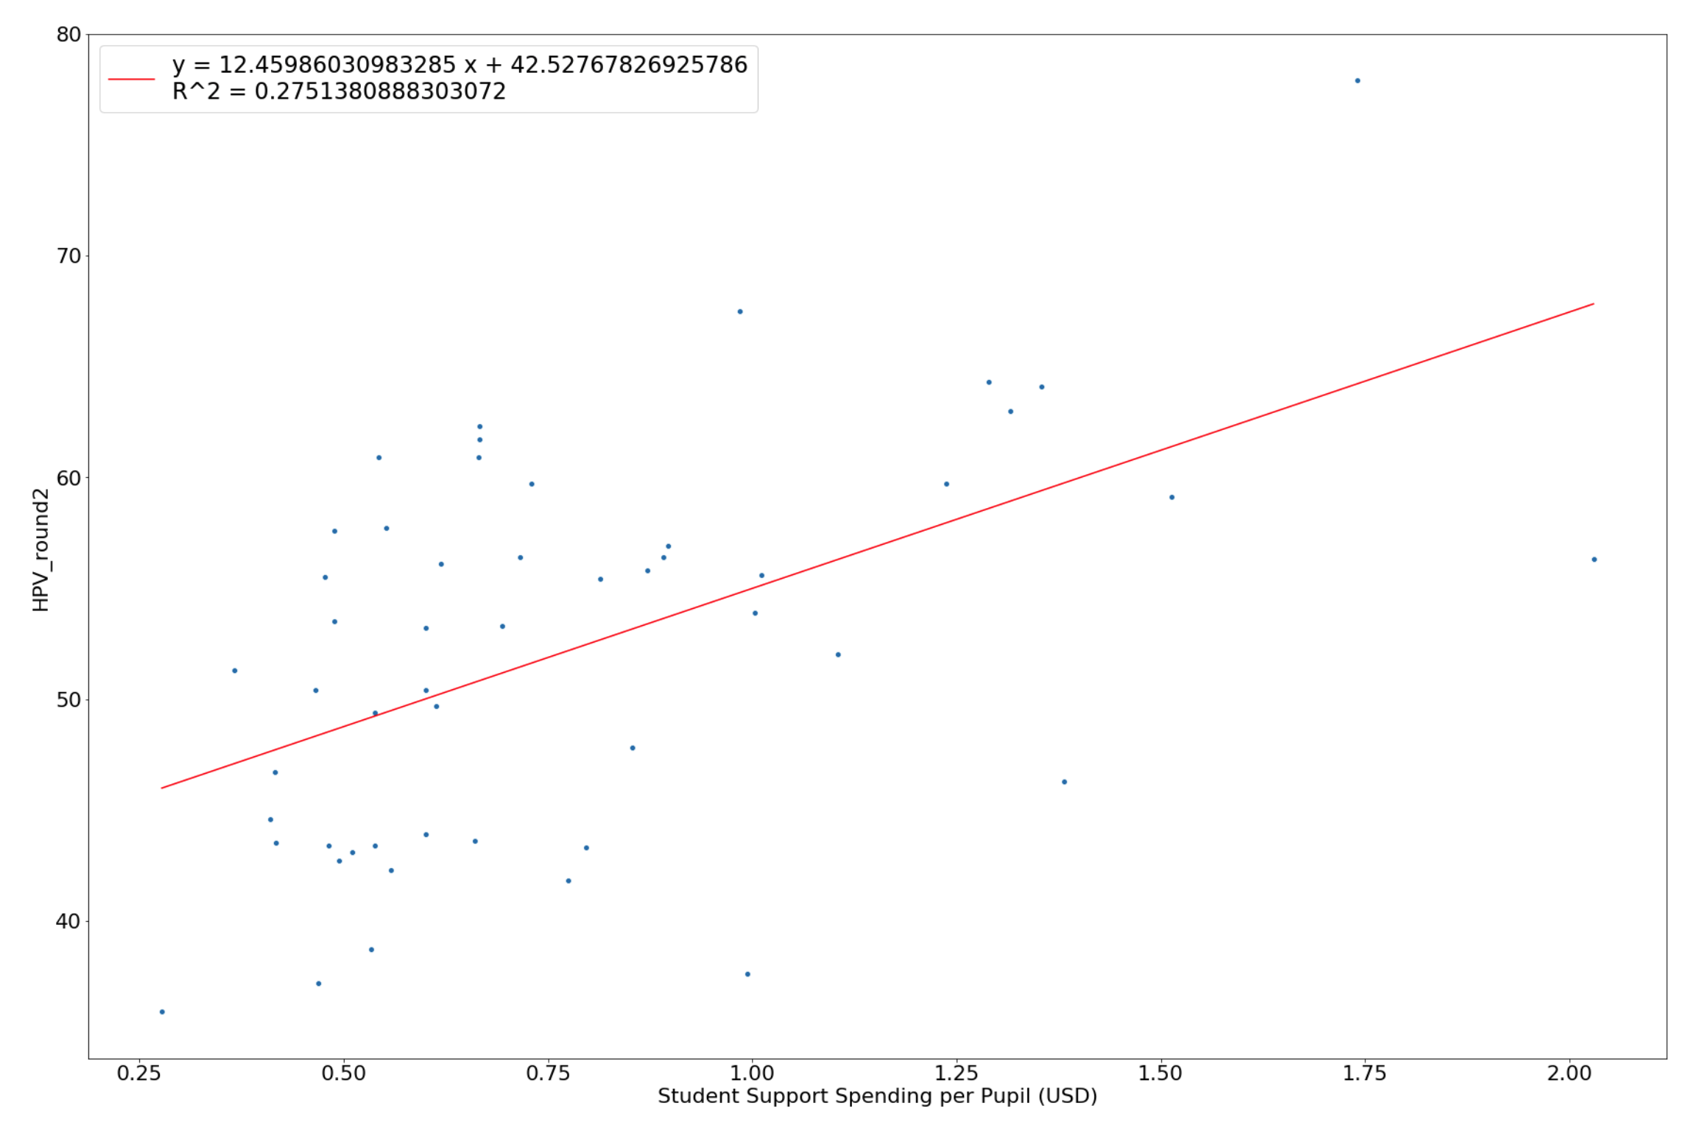
Correlating Student Support with 2nd Round of Vaccinations
Notes:
F stat = 9.481846307961963e-56
Pearson = (0.5274264489760621, 6.984009964428247e-05)

Slide 15
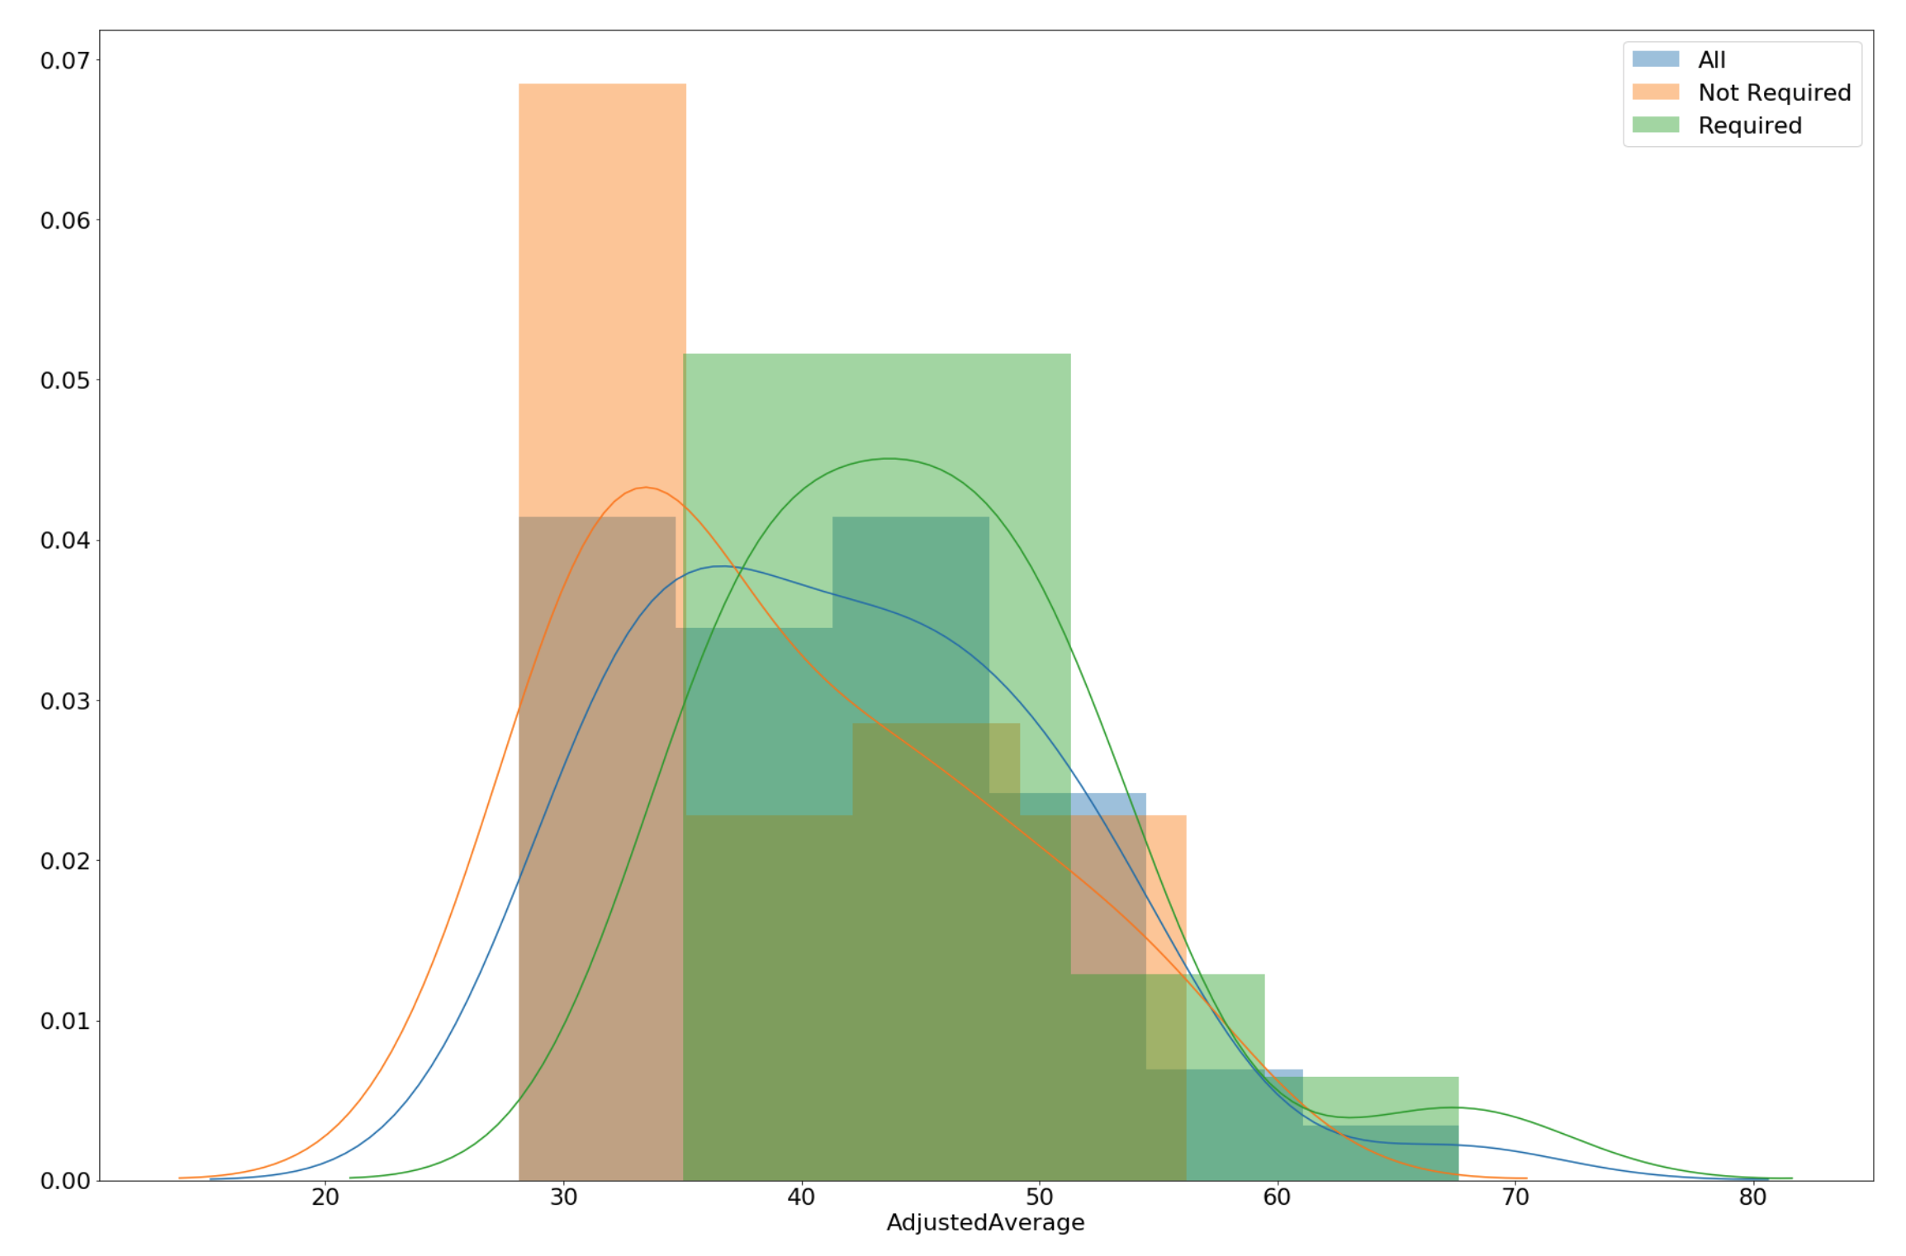
Considering some sex-ed data
Some states require sex-ed curriculums to include contraception.

Slide 16
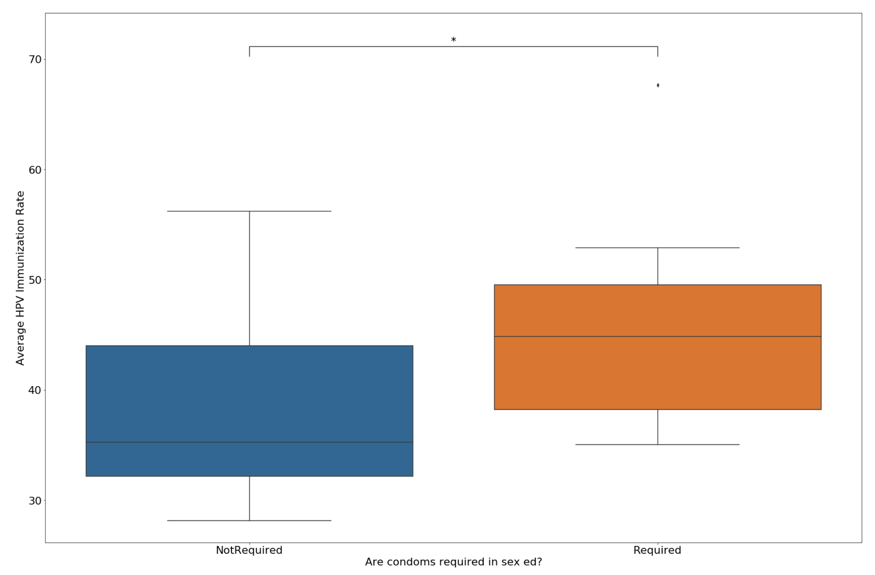
Considering some sex-ed data
Mann-Whitney-Wilcoxon
p-value = 0.0108
2-tailed independent t-test:
p-value = 0.0255

Slide 17
Conclusions
Increased education spending appears to have a positive impact on HPV vaccination rates
Including contraceptives in sexual education curriculums also appears to significantly affect HPV vaccination rates
Future work should refine the financial data to provide better estimates for how money is spent
should also correct for socioeconomic status as well as student-to-teacher ratios.

Slide 18
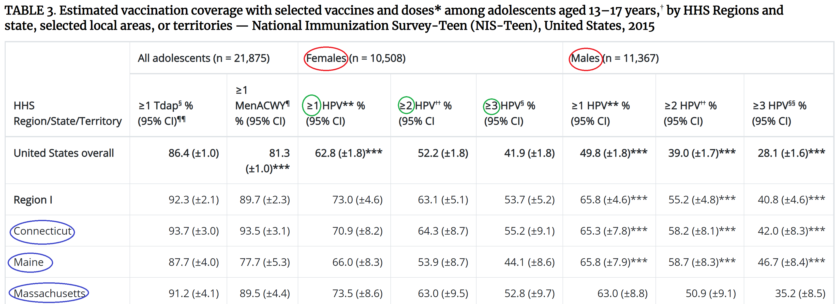
Sex education and HPV vaccination rates
More education
Higher quality education
Less parental involvement
Males greater than or equal to 3 shots

Slide 19
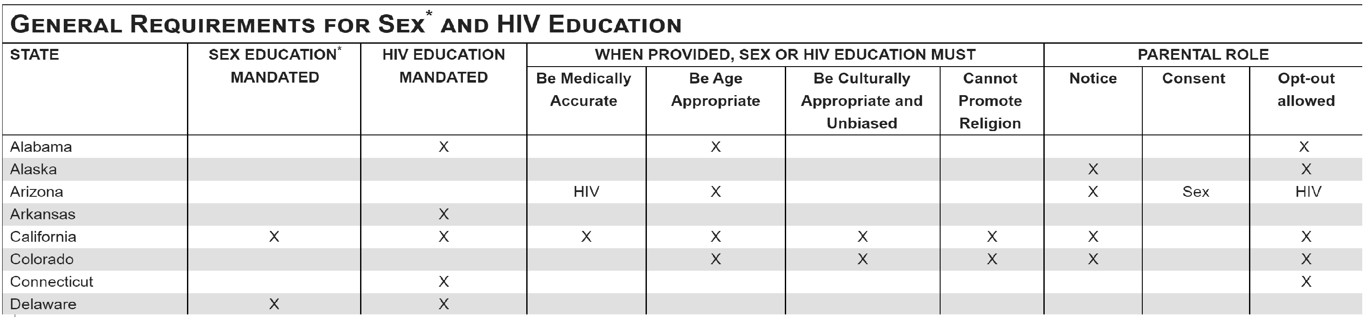
Variables I looked at
Mandated sex education
Medically accurate sex education (only 15 states require)
Both Mandated and medically accurate sex education
Parents given notice
Parent give consent

Slide 20



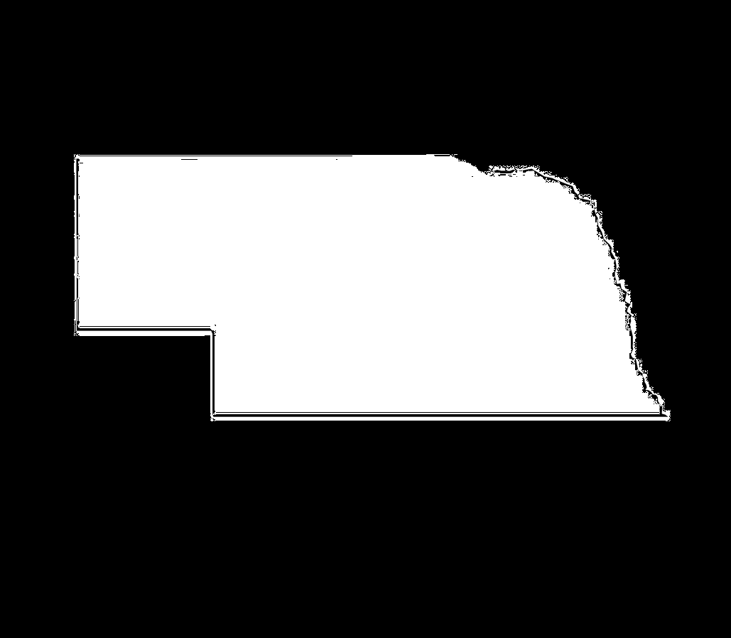

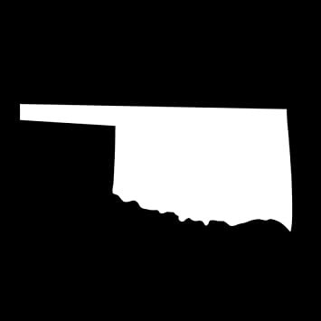
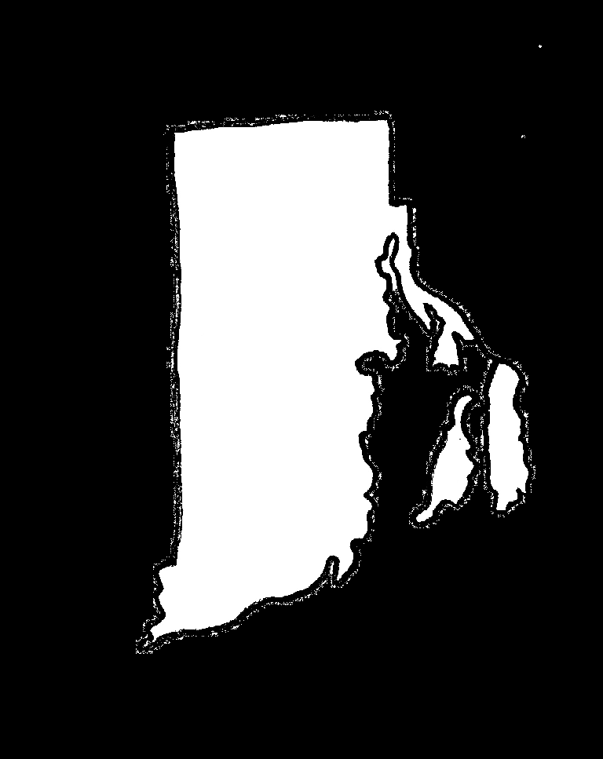
Data Issues
South Dakota, Wyoming, Nebraska –
No sex education data
Arizona and Oklahoma –
HIV education had to be accurate
Rhode Island –
Outlier

Slide 21
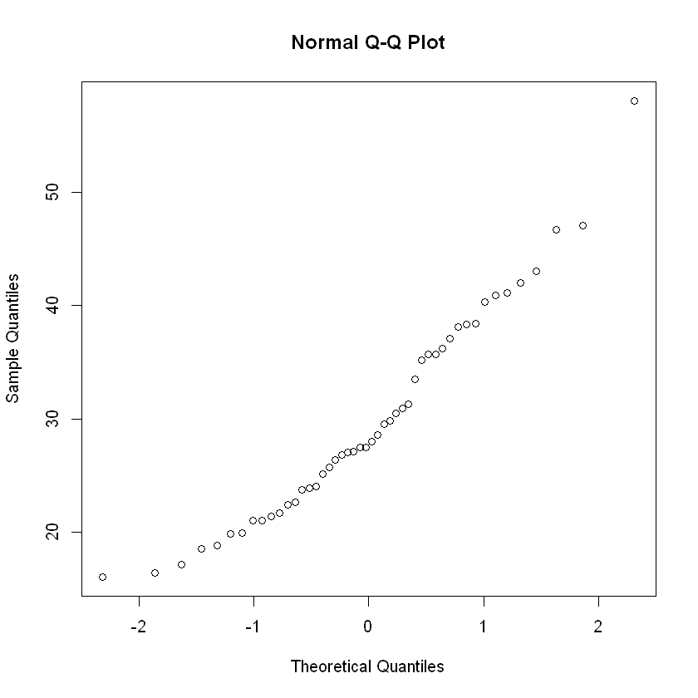
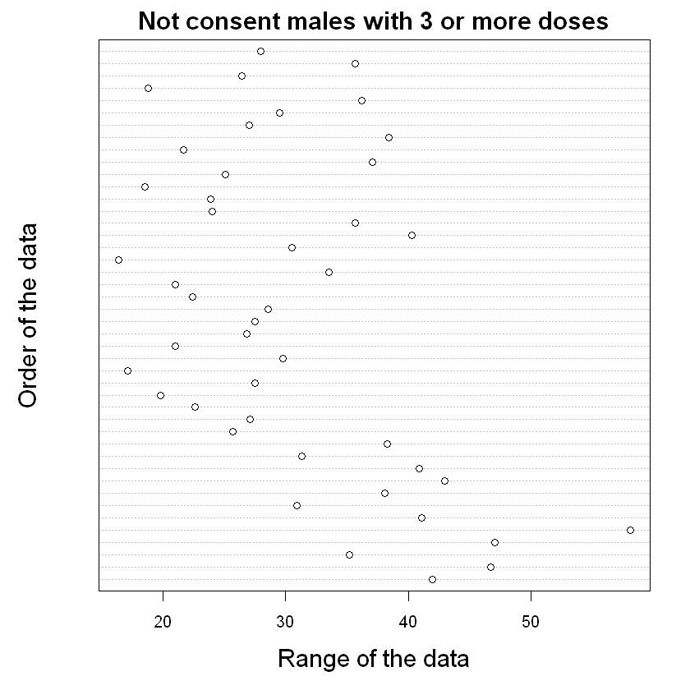
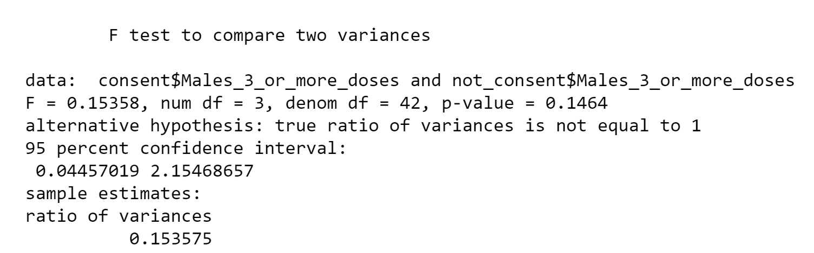
Assumptions
Checked for normalcy with qq plot
Checked for outliers with
dotplot and boxplot
Checked variance with F test
Used 2 sample t test for hypothesis testing

Slide 22
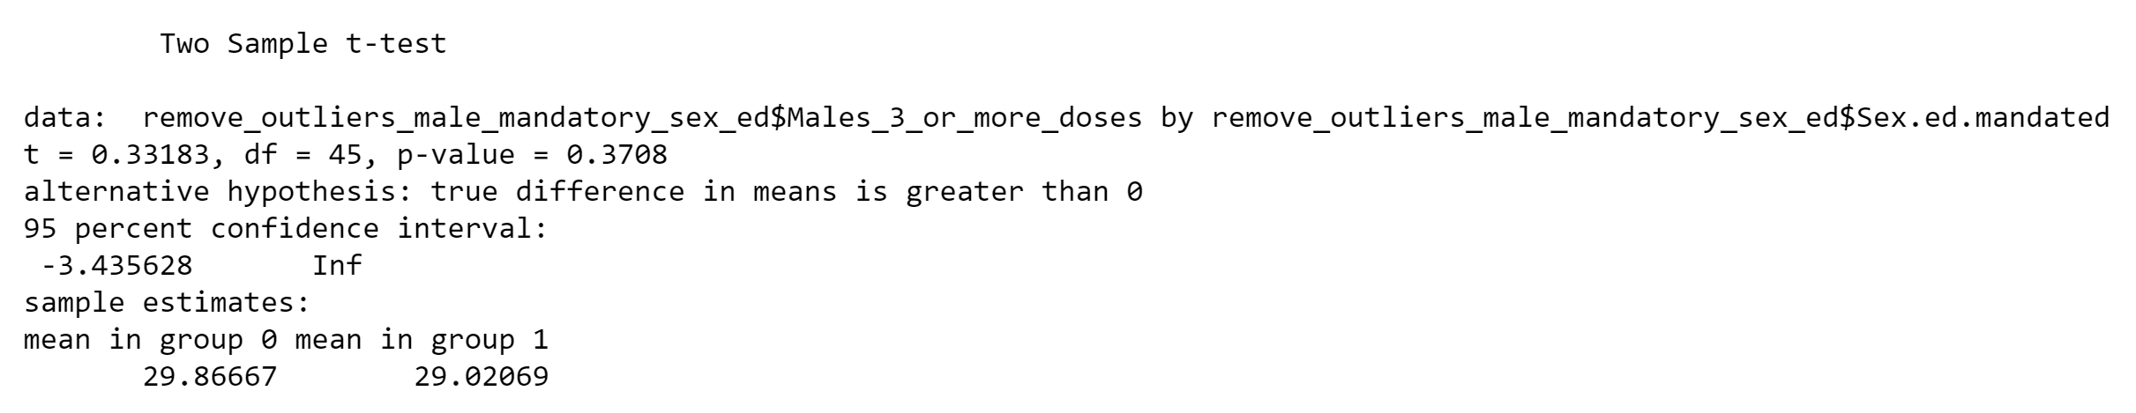
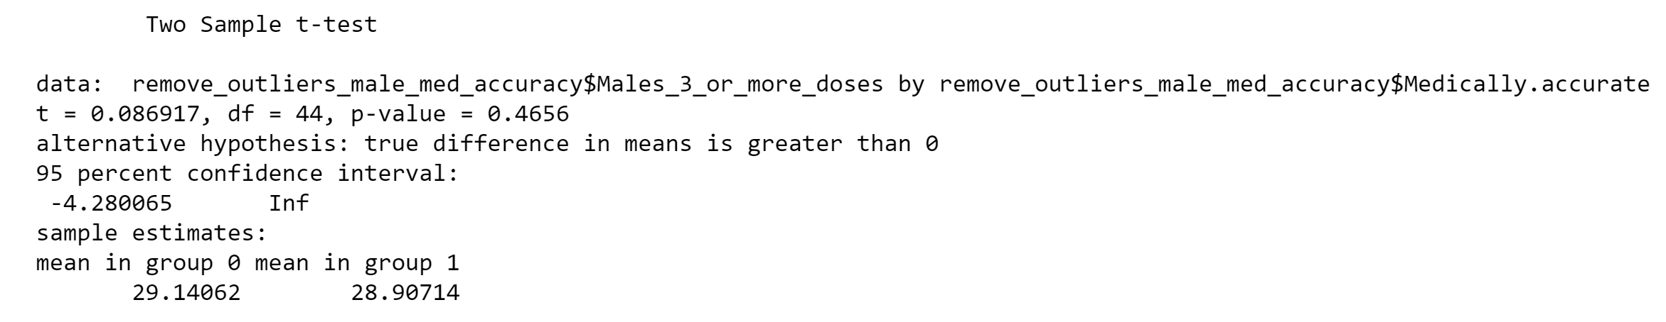
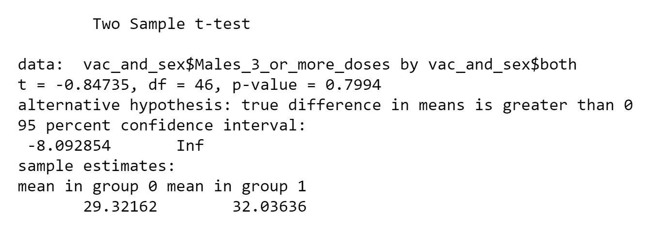
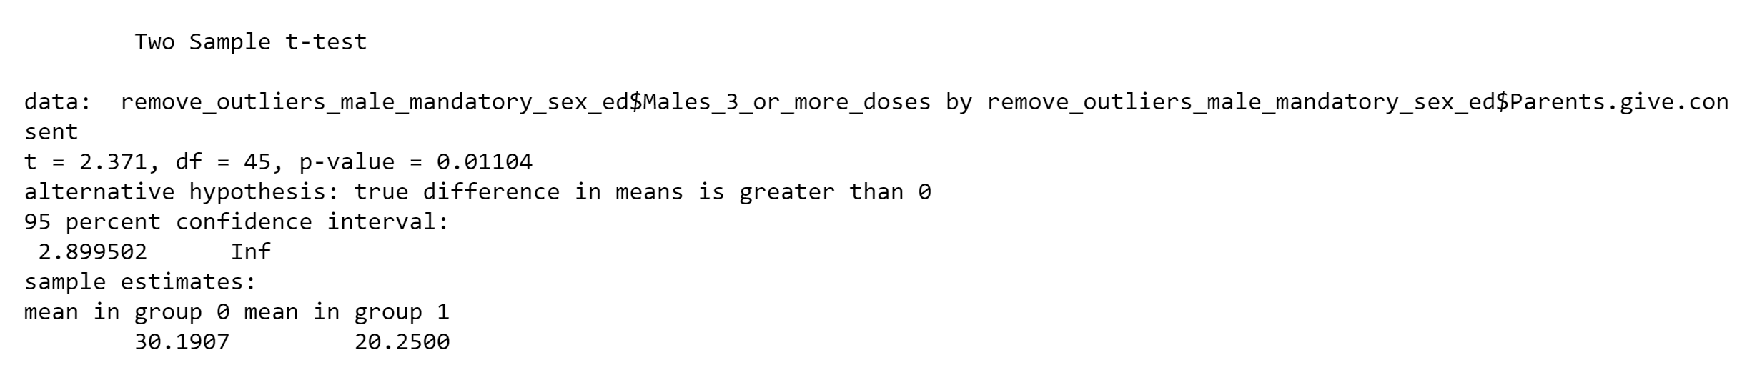
Results
Medically accurate, mandated sex ed,
both, Parental notice
Parental consent (p=0.01)
Regression (R squared=0.11)
Cleaning up data took forever, had more
time, multivariate regression with lots of
different variables

Slide 23
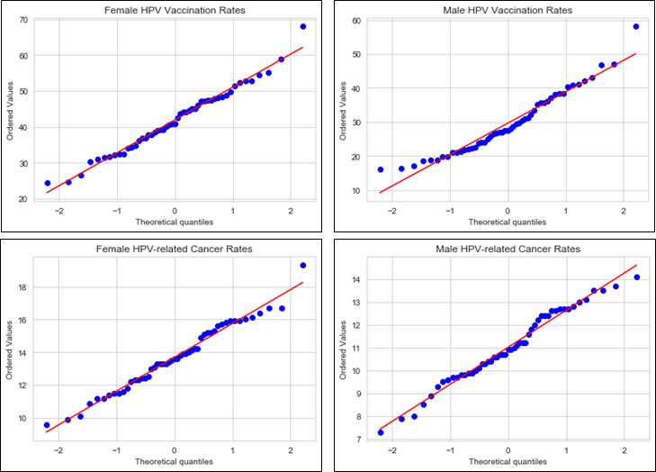
Comparisons
Female – HPV Vaccination vs Rates of Related Cancers
Male – HPV Vaccination vs Rates of Related Cancers
Female Cancer Rates vs Male Cancer rates
Tests
Pairplot
QQ Plots
Pearson correlation + p-value
Linear regression

Slide 24
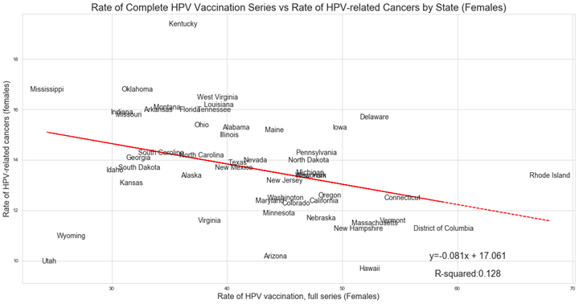
Pearson correlation: -0.3575
p-value: 0.010008

Slide 25
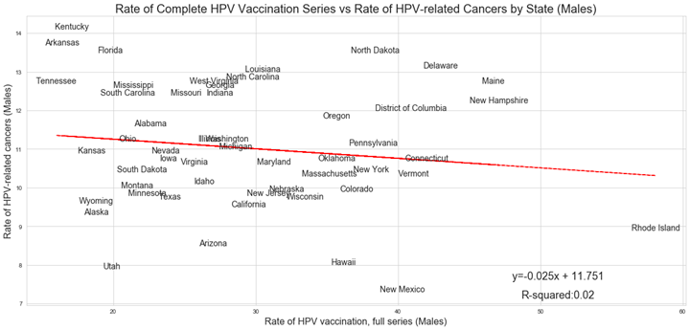
Pearson correlation: -0.1431
p-value: 0.31627

Slide 26
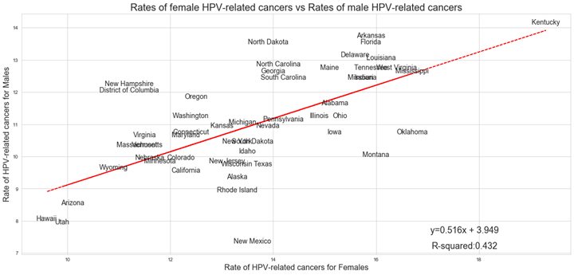
Pearson correlation: 0.65697
p-value: 1.64134 x 10⁻⁷

Slide 27
Conclusions
Accept or Reject?
Partial Acceptance (?) – The correlation between female HPV vaccination and cancer rates did appear to be statistically significant (p-value = 0.010008); however, the R-squared value is quite low, 0.128
The correlation between vaccination and cancer rates for males was not statistically significant (p-value = 0.31627) with even lower R-squared value, 0.02
Other factors likely play a role
Sex education quality
Sex education funding
Other unexplored factors
Strongest significance observed with the correlation between male and female HPV-related cancer rates (p-value = 1.64134 x 10⁻⁷)

Slide 28
Final Conclusions
How do HPV vaccination rates correlate to:
Education spending
More spending correlates to more immunizations
Sexual education program structure
Requiring parental consent correlates to lower male vaccination rate
Rates of HPV related cancers
Females show positive outcomes
Unclear with males

